Slide 1
Automated Lip Reading
Instructor: Lee-Ad Gottlieb, Ph.D.
Team Members: Tal Noam, Evgeny Vendrov, Amitai Zamir.

Slide 2
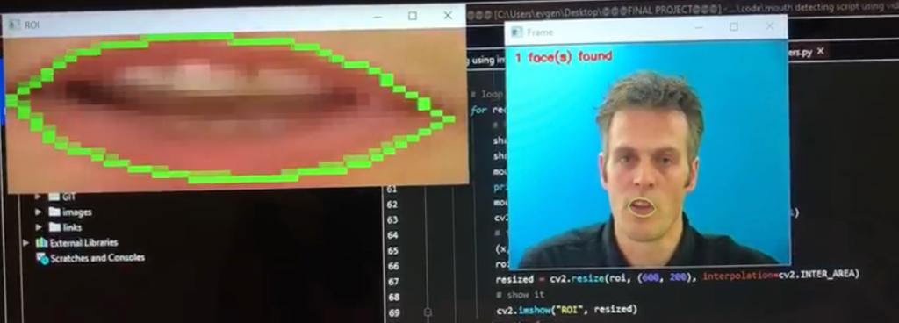
Our Purpose:
Our goal is to develop a machine learning algorithm, based on a DNN architecture, which is “trained” to extract spoken letters out of a voice-less video of a speaking person, based on the movement of speakers lips.

Slide 3
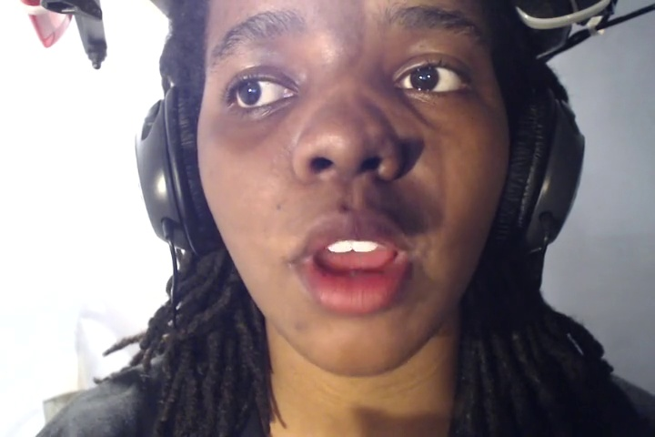
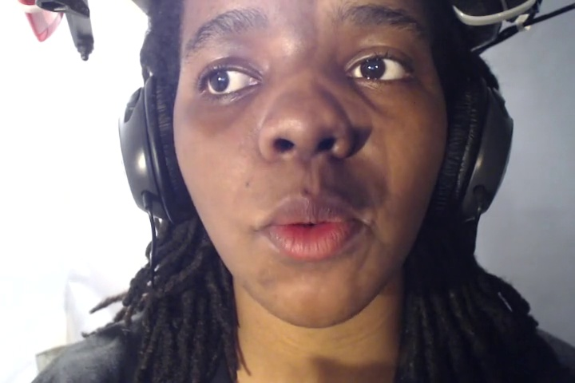
Dataset
Link: http://spandh.dcs.shef.ac.uk/avlombard/
Examples:
Every datapoint (i.e. a letter) is represented by 15 2D images which look like the two above.

Slide 4
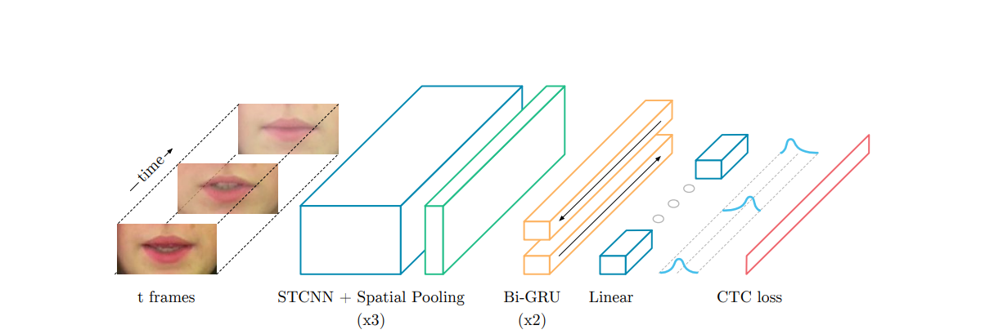
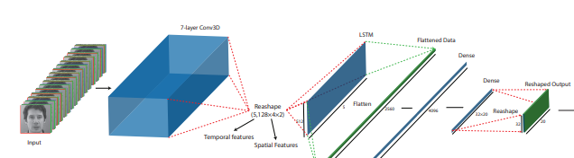
Architecture We Base On:
“LIPNET” architecture:
“Lip2AudSpec” architecture: (only the relevant part)

Slide 5
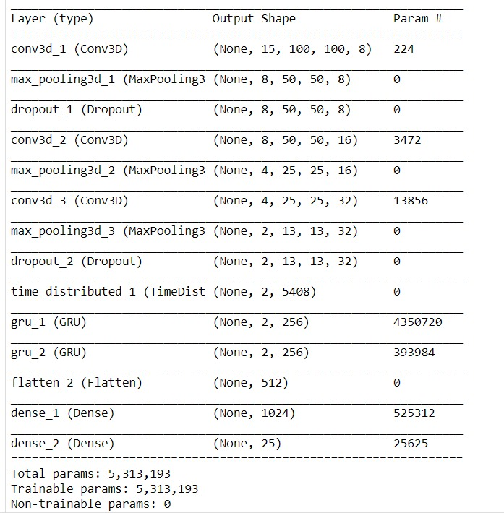
Architecture was actually used (model V2)

Slide 6
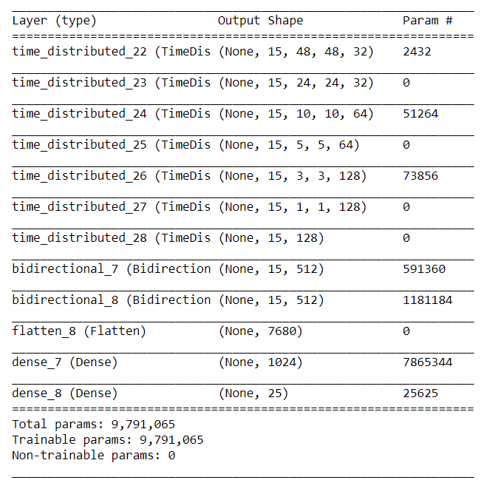
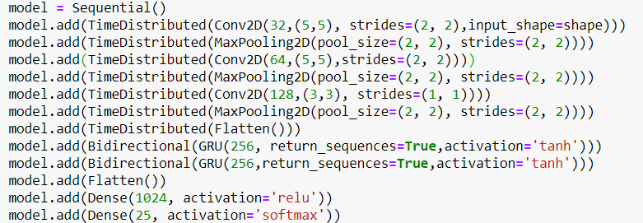
Architecture was actually used (model V3)

Slide 7
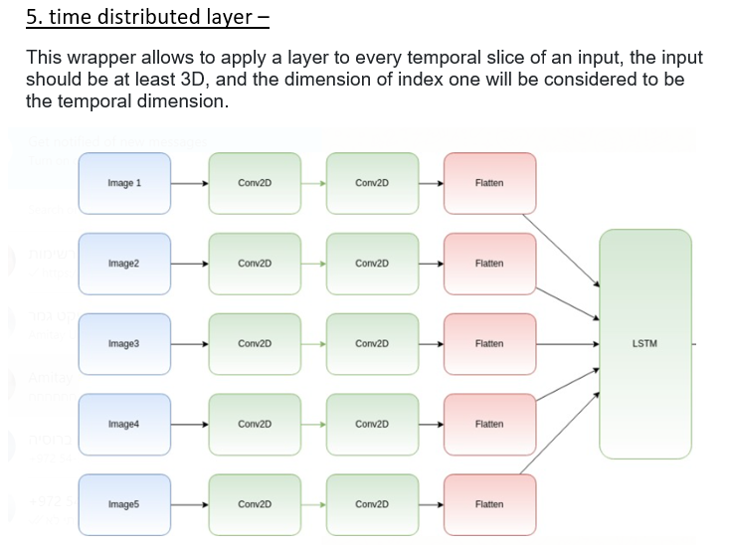
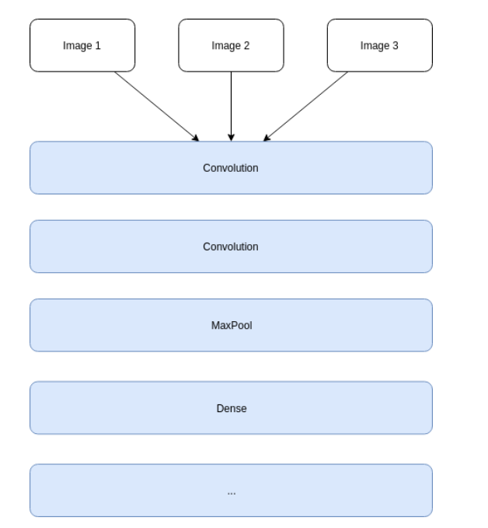
Difference:
VS

Slide 8
Work Distribution:
Amitai – all the work around the dataset (finding it, testing it, preprocessing it).
Tal – the researching part – finding papers of works similar to ours, finding theoretical information about our model and methodology, solving theoretical problems of the model and training, writing the official documents.
Evgeny – lip finding script and data preprocessing around it, writing the model and solving AWS problems around it.
Important note – most of the work was “thinking” what will work better and how to solve our problems (regarding the AWS or DL theory) – that we did together.

Slide 9
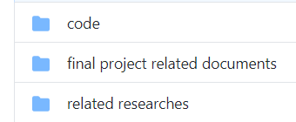
GitHub Repo:
Link: https://github.com/amitai1992/AutomatedLipReading
Code folder contains every code we ran on AWS
Documents folder contains all related documents we submitted
Researches folder contains researches we base on

Slide 10
Insights:
in a project like that you need a lot of knowledge in different and extensive areas, most of the problems in the project we encountered we had to go deeper and research solutions online to solve them. These problems could be solved with knowledge and experience in the field, things we did not have.
the frames we turned into images for the machine were not good enough. We used 100X100 face images while other studies used 100X50 lip images. We think we had to allow larger images for the machine to learn, but we ran into memory problems (each 100X100 image opens to a matrix much larger than it, double 15 frames for each video) so we could not enlarge the images. Our conclusion was therefore that the use of lip images only is absolutely necessary for learning.

